Slide 1
Classification of Human Activity Recognition using Active Learning technique
Final Project Presentation by
Alexander Faucheux
Alexander Floyd
Chitti Lakshmi Deepak D
Ryan Brown

Slide 2
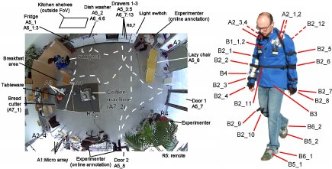
Introduction: : Using the Opportunity Activity Dataset, we attempted to create a model to find pattern and predict the human activities from sensor data and by incorporating active learning and training we worked toward a model that had a good accuracy rating. .

Slide 3
Dataset:
Opportunity Dataset for Human Activity Recognition from Wearable, Object and Ambient Sensors
Type | Float, Integer and Time-series
Source | Body-worn, Object, Ambient sensor data
Dimension | 250 Attributes and 240000 Instances (637,750)
Test Subjects | 4 user's actions were tracked at six different times (5 Daily Living activities and 1 Drill activity).

Slide 4
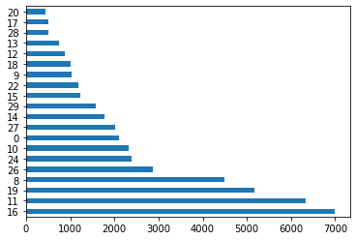
Exploratory Data Analysis
Dataset Overview
Class Balance ratio
MILLISEC | Acc_RKN_accX | Acc_RKN_accY | Acc_RKN_accZ | Acc_HIP_accX | Acc_HIP_accY | Acc_HIP_accZ | Acc_LUA_accX | Acc_LUA_accY | Acc_LUA_accZ | Acc_RUA_accX | Acc_RUA_accY | Acc_RUA_accZ
count | 4.70E+04 | 47000 | 47000 | 47000 | 47000 | 47000 | 47000 | 47000 | 47000 | 47000 | 47000 | 47000
mean | 7.27E+05 | -103.3934 | 836.782085 | 426.465745 | -316.67564 | 939.632936 | 35.701681 | 32.139766 | 925.36117 | 58.339106 | 367.261149 | 481.355809
std | 3.94E+05 | 271.040491 | 331.513334 | 462.539983 | 184.876727 | 137.714757 | 180.520523 | 292.433441 | 178.567234 | 310.097514 | 314.56416 | 522.714978
min | 9.85E+04 | -2724 | -2431 | -4401 | -2179 | -489 | -1439 | -1277 | -398 | -1624 | -2722 | -1893
25% | 4.54E+05 | -205 | 615 | 157 | -433 | 886 | -63 | -180 | 861 | -147 | 163 | 68
50% | 6.73E+05 | -109 | 934 | 406 | -304 | 955 | 44 | 9 | 950 | 7 | 366 | 605
75% | 9.08E+05 | -3 | 1024 | 803 | -189 | 1001 | 144 | 223 | 1015 | 227 | 577 | 894
max | 1.78E+06 | 2954 | 3051 | 4092 | 1516 | 3303 | 2790 | 2097 | 2473 | 1281 | 2292 | 2610

Slide 5
Specific Aims
KDD Process | Activity
Data Selection and Project Proposal | Choosing a dataset which aligns with team interests
Data Preprocessing | Finding the missing and infinite values, and fixing them
Data Transformation | Dimensionality Reduction by Active Learning &
 | Feature Selection
Data Mining Task selection | Training the model and predicting the test datasets by classification
Data mining algorithm selection and Implementation | Multiclass classifiers with K-fold cross validation
Knowledge Evaluation | Confusion Matrix – Accuracy, precision Comparison Graph

Slide 6
Methodology:
Implemented Project using Python Jupiter and with following libraries :
Numpy
Pandas
Sklearn (Classification)
Seaborn (Heatmap)
Matplotlib (Graphs)
modAL (Active Learning)

Slide 7
Data Pre-processing
Noisy Data
Many missing values
Filled with attribute mean
Missing Data
Removed rows with no data
Dependent Variables
7 Dependent variables
Combined into 1 using one-hot encoding

Slide 8
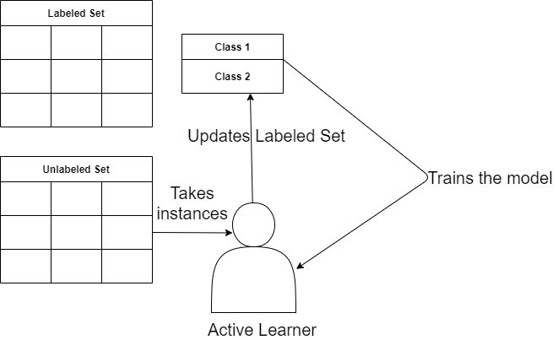
Data Transformation
Minimizing the dataset dimensions by:
• Active learning (Limiting the rows)
• Feature Selection (Reducing the attributes)
Initially trains the model with 1000 rows
Select next 1000 attributes based on uncertainty sampling
Continue Step 2 until accuracy <= 99 Initial rows = 240000
*Rows after AL = 47000

Slide 9

Data Transformation
Minimizing the dataset dimensions by:
• Active learning (Limiting the rows)
• Feature Selection (Reducing the attributes)
Tree based feature selection algorithm – Gini Importance
Calculate weights for each attribute
Take the attributes whose sum is 0.9 (Descending order)
Train the mode with new attributes Initial Attribute count : 243 **Attribute Count after FS : 170
Gini Impurity index:

Slide 10
Data Modeling using Random Forest and K-Nearest Neighbors
Random Forest
Useful for large ranges of data found
Very flexible and high accuracy
Overcomes overfitting by averaging different decision trees
K-Nearest Neighbors
Useful for nonlinear data with no assumption about data
Can be used for classification and regression

Slide 11
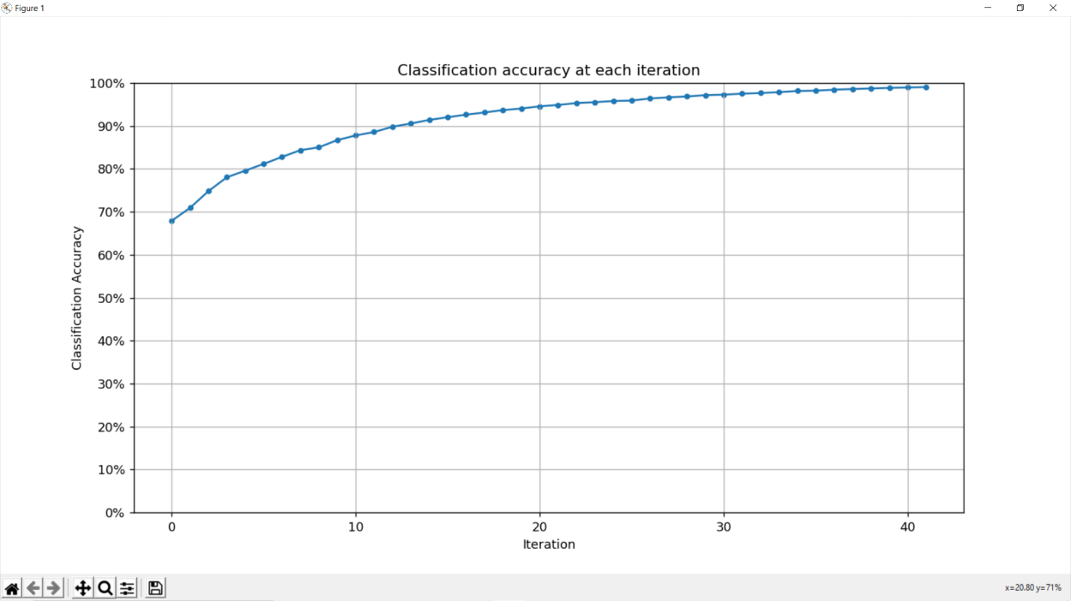
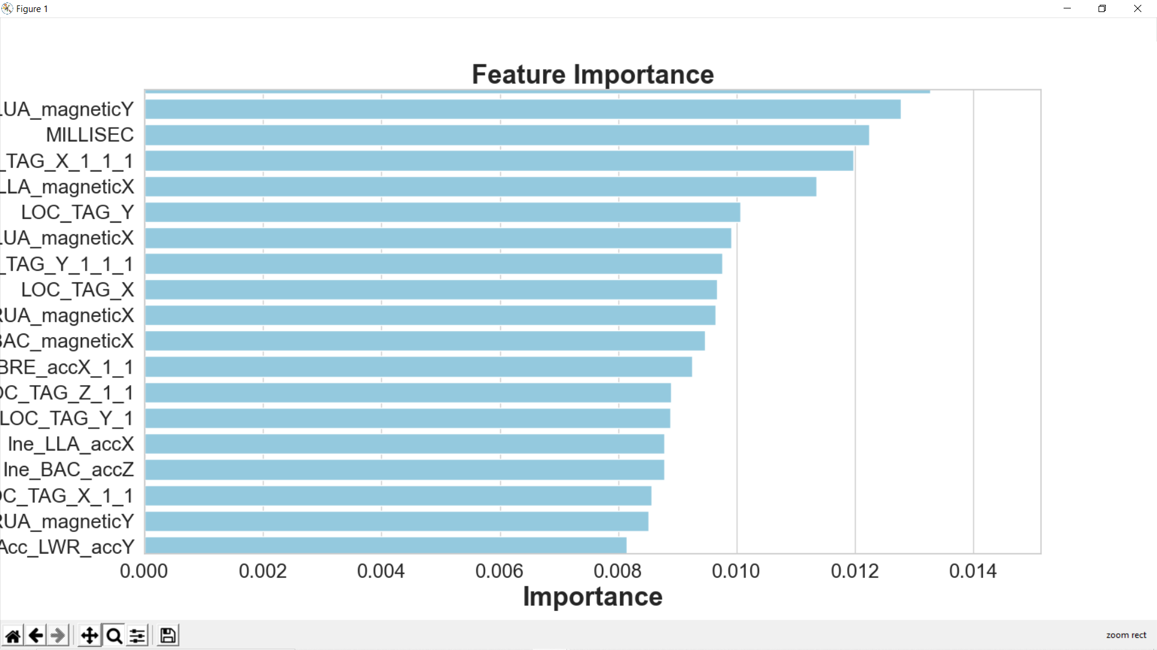
Accuracy at each iteration – Active Learning
Attributes Weights – Gini Importance

Slide 12
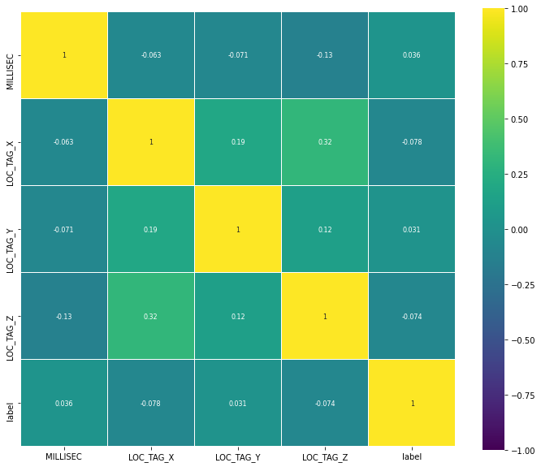
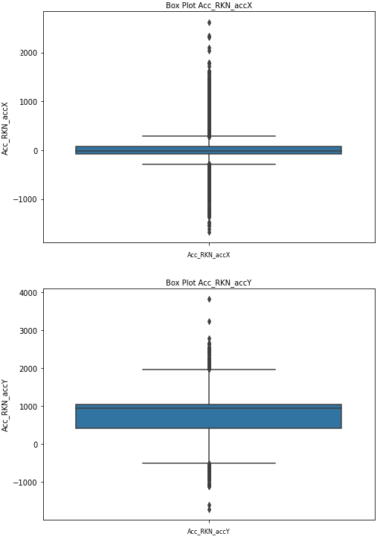
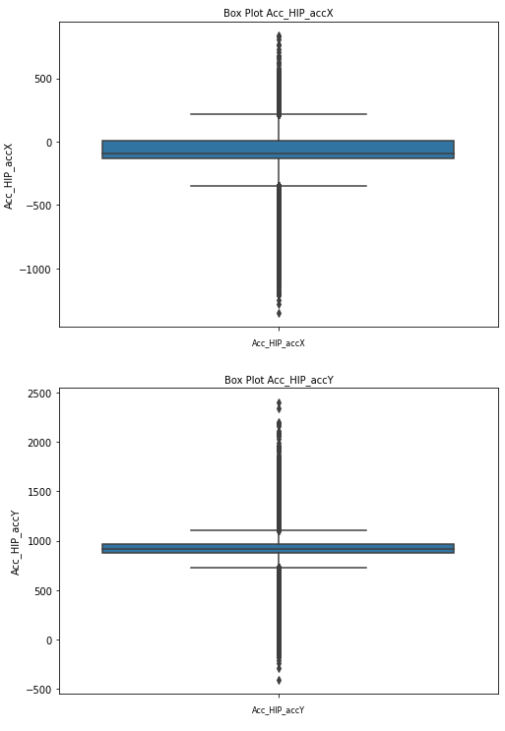
Exploratory Data Analysis
Correlation Matrix
Box Plot

Slide 13
Tasks & Timelines
Tasks | Week 1 | Week 2 | Week 3
Data selection | Deepak
Project Proposal | Team
Data Preprocessing |  | A. Floyd
Data Transformation |  | Deepak A. Floyd & Ryan
Data Mining & Modeling |  |  | Deepak & A. Faucheux
Evaluation |  |  | Ryan & Floyd

Slide 14
Hypothesis Review
• Initial hypothesis – KNN classifier is best suited for this dataset and it is difficult to find a pattern with multiple sensors
same data. Generate ROC curves • Evaluation hypo – Random forest classifier worked better than KNN
and attributes like Time, GPS location and Loco
attributes have good impact on the output label.

Slide 15
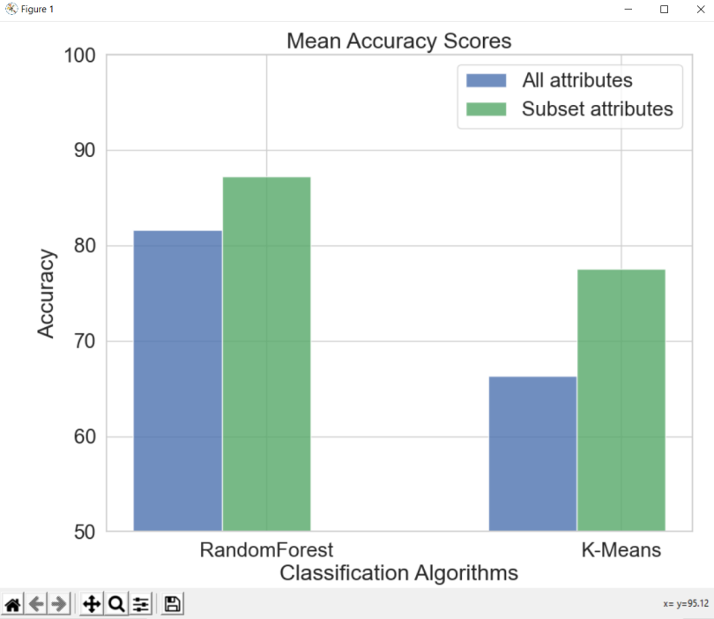
Evaluation & Results
 | accuracy | precision | recall | f1-score | Support
 | 0.87
macro avg |  | 0.81 | 0.72 | 0.77 | 2600
weighted avg |  | 0.88 | 0.87 | 0.87 | 2600
Initial Dataset: 250*240000 Reduced Dataset: 170*47000 (7.5% of Original Dataset)

Slide 16
References
• Dataset: https://archive.ics.uci.edu/ml/datasets/OPPORTUNITY+Activity+Recognition
•Active Learning in Python: https://modal-python.readthedocs.io/en/latest/content/models/ActiveLearner.html
• Active Learning: https://ieeexplore.ieee.org/document/8443399
• Random Forest Classification: https://medium.com/swlh/random-forest-classification-and-its-implementation-d5d840dbead0

Slide 17
THANK YOU

